Slide 1
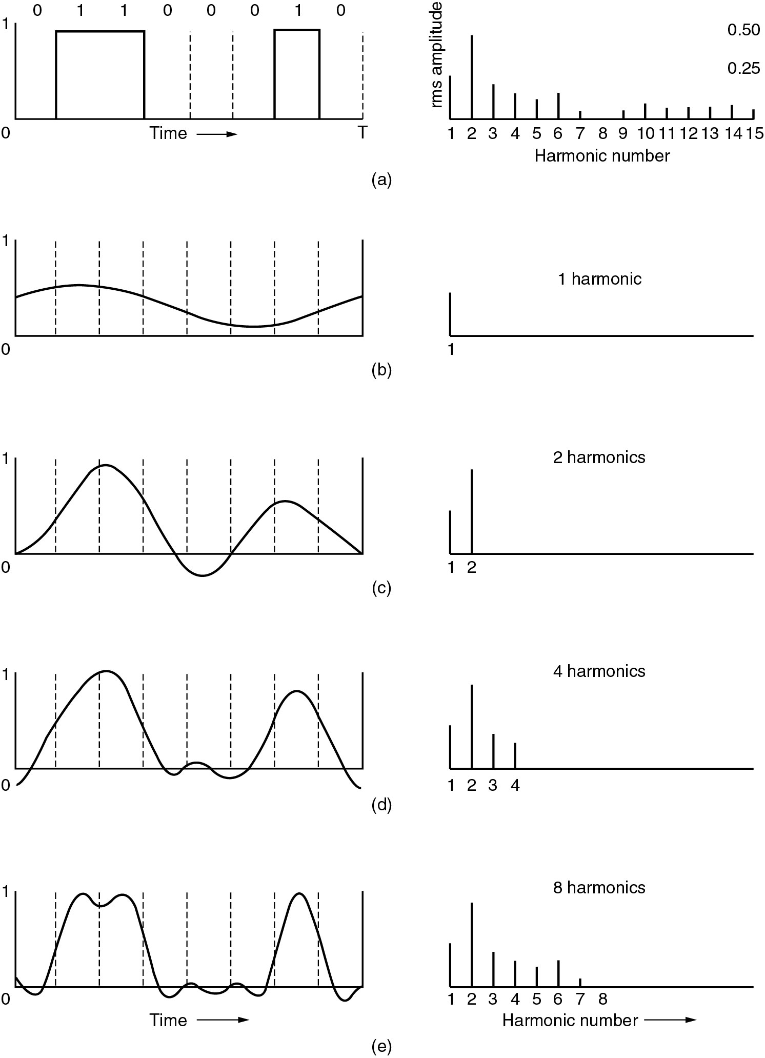
Bandwidth-Limited Signals

Slide 2
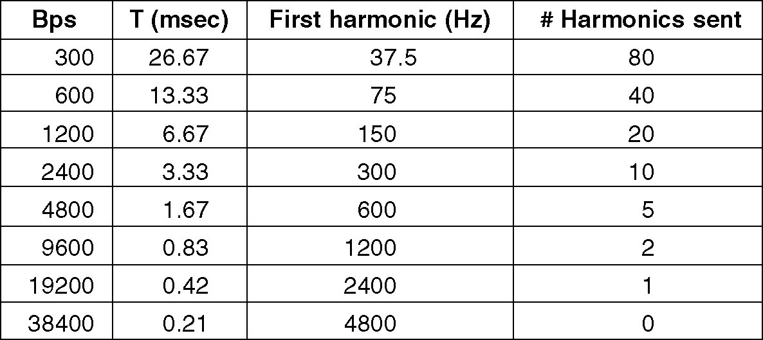
Bandwidth-Limited Signals
Relation between data rate and harmonics.

Slide 3
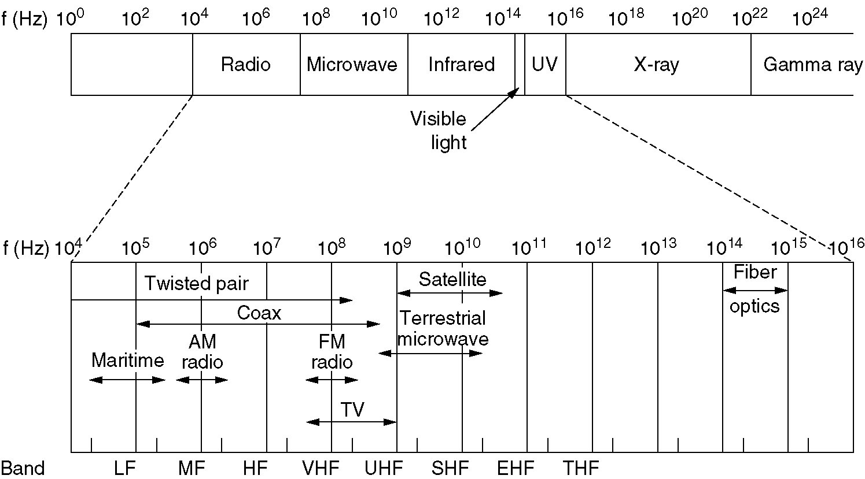
The Electromagnetic Spectrum
The electromagnetic spectrum and its uses for communication.

